Slide 1
‘In those days Israel had no king,; everyone did as he saw fit’ (Jug 21:25)
Israel sins
God’s J’ment
Drought, war, famine
People repent
Judge raised to deliver

Slide 2
Characteristics of Ruth
Repetitious phrases
  Ruth the Moabitess x 14: Coming to Bethlehem as a foreigner was a big-deal – stigma.
  ‘Loving kindness’ (HESED) glue to book – x 4 plus scenes of ‘hesed’ in action.
Structure (message = content + structure)
  Chiastic - an intentional structure to emphasize a climatic point

Slide 3
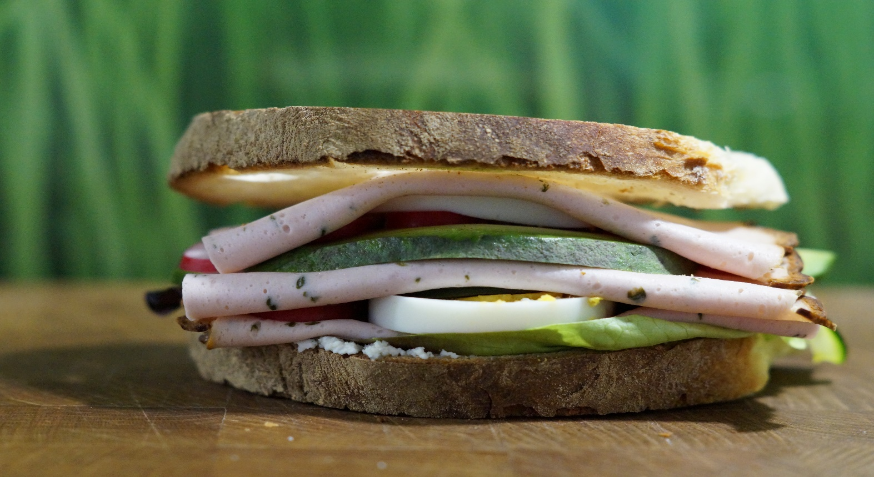
‘Why have I found favour in your eyes that you notice me, a foreigner’?
Ruth 2:10

Slide 4
Ch.1, scene 1, Hesed – kindness made clear by comparison.

Slide 5
HESED: A quality of exceptional, sacrificial, loyal kindness which begins in God’s heart, and He delights to see at work in His people.

Slide 6
The nature of HESED
· Force of Ruth’s disposition.
  V. 14, ‘clung’
  v.16 , ‘don’t urge me to leave you or turn back, where you go/stay I will go/stay...’
  v.17, ‘nothing will separate you & me…’
Ruth shows hesed, also embodies ‘hesed’.
  Fierce, forceful, passionate, loyal, determined, v.18.—
The nature of hesed!

Slide 7
Ch.1, scene 1, Hesed – kindness made clear by comparison.
Ch.2, scene 2, Hesed – kindness, its causes and consequences.

Slide 8
Foundational—Ruth made God her refuge
V.12b, ‘..under whose wings you have come to take refuge…’
  Gave her the freedom to show sacrificial kindness—hesed—to Naomi
V.11, Explains why she was able to leave, ‘father, mother, homeland’ & become a migrant missionary for sake of Naomi

Slide 9
2:3, God’s Providence (provision)
‘As it turned out she found herself working in a field belonging to Boaz’
Two Consequences of God’s Kindness through Ruth and Boaz
2:20, Naomi’s Repentance
‘He has not stopped showing His Kindness…’

Slide 10
Ch.1, scene 1, Hesed – kindness made clear by comparison.
Ch.2, scene 2, Hesed – kindness, its causes and consequences.
Ch.3, scene 3, Hesed – kindness that accumulates

Slide 11
Expectation: God will bless in response to kindness...
·v.10, ‘the Lord bless you… this kindness is greater than the one you showed before…’

Slide 12
‘Give and it will be given to you. A good measure pressed down, shaken together and running over, will be poured into your lap. For, with the measure you use it will be measured to you’.
(Luke 6:38)
Tally-onic Justice

Slide 13
Ch.1, scene 1, Hesed – kindness made clear by comparison - 1.
Ch.2, scene 2, Hesed – kindness, its causes and consequences.
Ch.3, scene 3, Hesed – kindness that accumulates.
Ch.4, scene 4, Hesed – kindness made clear by comparison - 2.

Slide 14
Kindness made clear by comparison - 2
· In chiastic arrangement a second comparison of characters (Boaz & near Kinsman at city gate, 4:1-8) mirrors earlier comparison of Ruth and Orpah (Ch.1)
  Earlier focus Ch.1—women (Ruth & Orpah) > issue: willingness to sacrifice personal marriage prospects > Ruth did the unusual & extraordinary and demonstrated HESED.
  Later focus—men (Boaz & Kinsman) > issue: willingness to sacrifice money, possession, inheritance > Boaz does the unusual & extraordinary and demonstrates hesed.
  V.6, ‘At this (i.e. acquiring Ruth with estate) the kinsman redeemer said, ‘…I cannot redeem it because I might endanger my own estate…I cannot do it’.
· Both demonstrate HESED, both designed for us to ask question —what would I have done?

Slide 15
Boaz becomes the Kinsman Redeemer
· 4:16-17, Obed is born > the grandfather of King David, ‘the father of Jesse, the father of David’
Matt Ch.1, follow Boaz’ birth-line 28 generations
Matt. Ch.1:16, ‘...Jacob the father of Joseph, husband of Mary, of whom was born Jesus, who is called Christ.’

Slide 16
‘For God so loved the world that He gave His only Son…’ Jn 3:16
But God demonstrated his own love for us in this: While we were still sinners Christ died for us.’ Rom 5:8

Slide 17
Lessons Learned
· If Ruth hadn’t shown kindness:
  Lives wouldn’t have been changed in B/hem, and
  Christ wouldn’t come!
· Likewise - Our daily decisions to show ‘hesed’, in hands of God
  Affect community
  Affect eternity

